Slide 1
Support Vector Learning*
Damian A. Tamburri, Ph.D.
*slides courtesy of JADS

Slide 2
What will you learn today?
What t.h. are SVMs?
What are their functioning principles?
When do I use them?

Slide 3
History of SVM
SVM is related to statistical learning theory [3]
SVM was first introduced in 1992 [1]
SVM becomes popular because of its success in handwritten digit recognition
1.1% test error rate for SVM. This is the same as the error rates of a carefully constructed neural-network, LeNet 4.
See Section 5.11 in [2] or the discussion in [3] for details;
SVM is now regarded as an important example of “kernel methods”, one of the key areas in machine-learning
Notes:
First introduced in COLT-92 by Boser, Guyon and Vapnik
COLT = computational learning theory
B. Scholkopf et al. ICANN 96. 47-52.
[1] B.E. Boser et al. A Training Algorithm for Optimal Margin Classifiers. Proceedings of the Fifth Annual Workshop on Computational Learning Theory 5 144-152, Pittsburgh, 1992.
[2] L. Bottou et al. Comparison of classifier methods: a case study in handwritten digit recognition. Proceedings of the 12th IAPR International Conference on Pattern Recognition, vol. 2, pp. 77-82.
[3] V. Vapnik. The Nature of Statistical Learning Theory. 2nd edition, Springer, 1999.

Slide 4
Back in our ANN times…
ANNs are good when problem decision surface is linearly separable (Perceptron Convergence Theorem)
More advanced ANNs are needed when problem is not linearly separable

Slide 5
Back in our ANN times…
ANNs are good when problem decision surface is linearly separable (Perceptron Convergence Theorem)
Just because I converge doesn’t mean I’m finding the optimal solution!
More advanced ANNs are needed when problem is not linearly separable
Let’s just change the way we reason on the problem rather than improving the architecture that deals with it!

Slide 6
Back in our ANN times…
ANNs are good when problem decision surface is linearly separable (Perceptron Convergence Theorem)
Just because I converge doesn’t mean I’m finding the optimal solution!
More advanced ANNs are needed when problem is not linearly separable
Let’s just change the way we reason on the problem rather than improving the architecture that deals with it! SVMs ☺

Slide 7
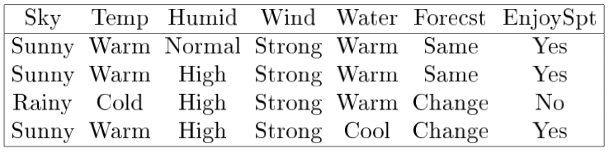
Let’s go step by step…
1. I have some data, e.g., my tennis-playing dataset

Slide 8
Let’s go step by step…
2. I can reduce it to some numerical/categorical feature space
Temperature
Humidity
= play tennis
= do not play tennis

Slide 9
Let’s go step by step…
3. I can generalize this reduction per every feature
Y
X
= +1 (play tennis)
= -1 (do not play tennis)

Slide 10
Let’s go step by step…
x
f
y^{est}
f(x,w,b) = sign(w x + b)
denotes +1
denotes -1
w x + b>0
w x + b=0
How would you classify this data?
w x + b<0

Slide 11
Let’s go step by step…
This is just my
problem formulation!
x
f
y^{est}
f(x,w,b) = sign(w x + b)
denotes +1
denotes -1
w x + b>0
w x + b=0
How would you classify this data?
w x + b<0

Slide 12
Let’s go step by step…
I want the function of x,w,b that discriminates between
Two semi-planes…
x
f
y^{est}
f(x,w,b) = sign(w x + b)
denotes +1
denotes -1
w x + b>0
w x + b=0
How would you classify this data?
w x + b<0

Slide 13
Let’s go step by step…
I want the function of x,w,b that discriminates between
Two semi-planes…
x
f
y^{est}
f(x,w,b) = sign(w x + b)
denotes +1
denotes -1
w x + b>0
w x + b=0
How would you classify this data?
w x + b<0

Slide 14
Let’s go step by step…
I want the function of x,w,b that discriminates between
Two semi-planes…
x
f
y^{est}
f(x,w,b) = sign(w x + b)
denotes +1
denotes -1
w x + b>0
w x + b=0
How would you classify this data?
w x + b<0

Slide 15
α
Let’s go step by step…
x
f
y^{est}
f(x,w,b) = sign(w x + b)
denotes +1
denotes -1
How would you classify this data?

Slide 16
α
Let’s go step by step…
x
f
y^{est}
f(x,w,b) = sign(w x - b)
denotes +1
denotes -1
How would you classify this data?

Slide 17
α
Let’s go step by step…
x
f
y^{est}
f(x,w,b) = sign(w x * b)
denotes +1
denotes -1
Any of these would be fine..
..but which is best?

Slide 18
α
Let’s go step by step…
x
f
y^{est}
f(x,w,b) = sign(w x * b)
denotes +1
denotes -1
Simple!
..the one which distinguishes the classes and is as far away as possible from each class!

Slide 19
α
Let’s go step by step…
x
f
y^{est}
f(x,w,b) = sign(w x * b)
denotes +1
denotes -1
So…
Let’s draw one straight line from the “last” two points of one class

Slide 20
α
Let’s go step by step…
x
f
y^{est}
f(x,w,b) = sign(w x * b)
denotes +1
denotes -1
and…
Let’s do the same for the other class…

Slide 21
α
Let’s focus on the two
Boundary ones…
x
f
y^{est}
f(x,w,b) = sign(w x * b)
denotes +1
denotes -1
Now… Can I find a single line with geometrical properties that make it equivalent to the these two?

Slide 22
α
Let’s focus on the two
Boundary ones…
x
f
y^{est}
f(x,w,b) = sign(w x * b)
denotes +1
denotes -1
Yes I can! ☺

Slide 23
α
Let’s focus on the two
Boundary ones…
x
f
y^{est}
f(x,w,b) = sign(w x * b)
denotes +1
denotes -1
Yes I can! ☺
1. First, I draw one line inbetween these two

Slide 24
α
Let’s focus on the two
Boundary ones…
x
f
y^{est}
f(x,w,b) = sign(w x * b)
denotes +1
denotes -1
Yes I can! ☺
2. Then I make it bigger

Slide 25
α
Let’s focus on the two
Boundary ones…
x
f
y^{est}
f(x,w,b) = sign(w x * b)
denotes +1
denotes -1
Yes I can! ☺
3. And bigger…

Slide 26
α
Let’s focus on the two
Boundary ones…
x
f
y^{est}
f(x,w,b) = sign(w x * b)
denotes +1
denotes -1
Yes I can! ☺
4. And bigger!

Slide 27
α
Let’s focus on the two
Boundary ones…
x
f
y^{est}
f(x,w,b) = sign(w x * b)
denotes +1
denotes -1
Yes I can! ☺
5. I vary the line slope to maximize its *width* even further

Slide 28
α
Let’s focus on the two
Boundary ones…
x
f
y^{est}
f(x,w,b) = sign(w x * b)
denotes +1
denotes -1
Yes I can! ☺
5. I vary the line slope to maximize its *width* even further

Slide 29
α
And there you have it!
x
f
y^{est}
f(x,w,b) = sign(w x * b)
denotes +1
denotes -1
Hold on… I get it!
5. Let me define the margin of my classifier as the width that the boundary line could be increased by, before hitting a datapoint!

Slide 30
Support-Vector Machines: Classifying by margin maximization
Maximizing the margin is good according to intuition
Implies that only support vectors are important; other training examples are ignorable.
Empirically it works very very well.
f(x,w,b) = sign(w x + b)
denotes +1
denotes -1
The maximum margin linear classifier is the linear classifier with the, um, maximum margin.
This is the simplest kind of SVM (Called an LSVM)
Support Vectors are those datapoints that the margin pushes up against
Linear SVM

Slide 31
Support-Vector Machines: Classifying by margin maximization
Maximizing the margin is good according to intuition
Implies that only support vectors are important; other training examples are ignorable.
Empirically it works very very well.
f(x,w,b) = sign(w x + b)
denotes +1
denotes -1
The maximum margin linear classifier is the linear classifier with the, um, maximum margin.
LSVM searches for a separating hyperplane!
Support Vectors are those datapoints that the margin pushes up against

Slide 32
What is a hyperplane?
As a simple example, for a classification task with only two features, you can think of a hyperplane as a line that linearly separates and classifies a set of data;
Intuitively, the further from the hyperplane our data points lie, the more confident we are that they have been correctly classified. We therefore want our data points to be as far away from the hyperplane as possible, while still being on the correct side of it;
So when new testing data are added, whatever side of the hyperplane it lands will decide the class that we assign to it.

Slide 33
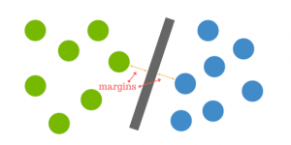
How do we find the right hyperplane?
How do we best segregate the two classes within the data?
The distance between the hyperplane and the nearest data point from either set is known as the margin.
The goal is to choose a hyperplane with the greatest possible margin between the hyperplane and any point within the training set, giving a greater chance of new data being classified correctly. There will never be any data point inside the margin.

Slide 34
Linear SVM Mathematically
x⁺
M=Margin Width
“Predict Class = +1” zone
X⁻
wx+b=1
“Predict Class = -1” zone
wx+b=0
wx+b=-1

Slide 35

Linear SVM Mathematically
x⁺
M=Margin Width
“Predict Class = +1” zone
X⁻
wx+b=1
We want to maximise this area…
“Predict Class = -1” zone
wx+b=0
wx+b=-1

Slide 36
Linear SVM Mathematically
…
x⁺
M=Margin Width
“Predict Class = +1” zone
X⁻
wx+b=1
“Predict Class = -1” zone
wx+b=0
wx+b=-1
What we know:
wx⁺ + b = +1

Slide 37
Linear SVM Mathematically
x⁺
M=Margin Width
“Predict Class = +1” zone
X⁻
wx+b=1
“Predict Class = -1” zone
wx+b=0
wx+b=-1
…
What we know:
wx⁺ + b = +1
wx⁻ + b = -1

Slide 38
Linear SVM Mathematically
x⁺
M=Margin Width
“Predict Class = +1” zone
X⁻
wx+b=1
“Predict Class = -1” zone
wx+b=0
wx+b=-1
What we know:
wx⁺ + b = +1
wx⁻ + b = -1
Area to be maximized:
[wx⁺ + b = +1] – [wx⁻ + b = -1]
Notes:
a data point is viewed as a p {\displaystyle p} -dimensional vector (a list of p {\displaystyle p} numbers), and we want to know whether we can separate such points with a ( p − 1 ) {\displaystyle (p-1)} -dimensional hyperplane.

Slide 39
Linear SVM Mathematically
x⁺
M=Margin Width
“Predict Class = +1” zone
X⁻
wx+b=1
“Predict Class = -1” zone
wx+b=0
wx+b=-1
Nothing fancy, just
Mathematical reduction!
What we know:
wx⁺ + b = +1
wx⁻ + b = -1
w(x⁺-x⁻⁾ = 2
Notes:
An SVM model is a representation of the examples as points in space, mapped so that the examples of the separate categories are divided by a clear gap that is as wide as possible. New examples are then mapped into that same space and predicted to belong to a category based on which side of the gap they fall.

Slide 40
Linear SVM Mathematically
Goal: 1) Correctly classify all training data
if y_{i} = +1
if y_{i} = -1
for all i
2) Maximize the Margin

Slide 41
Linear SVM Mathematically
Goal: 1) Correctly classify all training data
if y_{i} = +1
if y_{i} = -1
for all i
2) Maximize the Margin
same as minimize

Slide 42
Linear SVM Mathematically
Goal: 1) Correctly classify all training data
if y_{i} = +1
if y_{i} = -1
for all i
2) Maximize the Margin
same as minimize
Minimize

Slide 43
Linear SVM Mathematically
Goal: 1) Correctly classify all training data
if y_{i} = +1
if y_{i} = -1
for all i
2) Maximize the Margin
same as minimize
Minimize
subject to
We also have to prevent data points from falling into the margin!

Slide 44
Linear SVM Mathematically
Goal: 1) Correctly classify all training data
if y_{i} = +1
if y_{i} = -1
for all i
2) Maximize the Margin
same as minimize
Minimize
subject to
Here’s a good question:
Q. Is there a way to do this, geometrically?

Slide 45
Linear SVM Mathematically
Goal: 1) Correctly classify all training data
if y_{i} = +1
if y_{i} = -1
for all i
2) Maximize the Margin
same as minimize
Minimize
subject to
Here’s a good question:
A. Of course there is ☺

Slide 46
Linear SVM Mathematically
Goal: 1) Correctly classify all training data
if y_{i} = +1
if y_{i} = -1
for all i
2) Maximize the Margin
same as minimize
Minimize
subject to
Here’s a good question:
A. Of course there is ☺
I can use the «Distance from a point to a plane» equation!

Slide 47
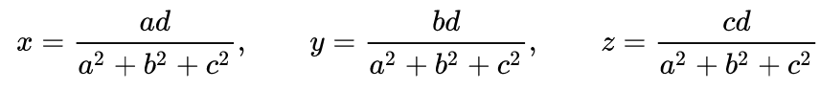
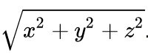
Euclidean Geometry Intermezzo
In Euclidean space, the point on a plane ax + by + cz = d that is closest to the origin has the Cartesian coordinates (x, y, z) where:
Applying the Pythagorean Theorem, I’ll get:
d =
Notes:
https://en.wikipedia.org/wiki/Distance_from_a_point_to_a_plane

Slide 48
Euclidean Geometry Intermezzo
In Euclidean space, the point on a plane ax + by + cz = d that is closest to the origin has the Cartesian coordinates (x, y, z) where:
Applying the Pythagorean Theorem, I’ll get:
d =
Notes:
https://en.wikipedia.org/wiki/Distance_from_a_point_to_a_plane

Slide 49
Euclidean Geometry Intermezzo
In Euclidean space, the point on a plane ax + by + cz = d that is closest to the origin has the Cartesian coordinates (x, y, z) where:
Applying the Pythagorean Theorem, I’ll get:
d =
Hold on… this is a distance from a point to the origin of a plane, I can also change the origin to any point on that plane!
Notes:
https://en.wikipedia.org/wiki/Distance_from_a_point_to_a_plane

Slide 50
Euclidean Geometry Intermezzo
In Euclidean space, the point on a plane ax + by + cz = d that is closest to the origin has the Cartesian coordinates (x, y, z) where:
Applying the Pythagorean Theorem, I’ll get:
d =
Which means I can compute the distance for all datapoints aaaaAAANDDDD?
Notes:
https://en.wikipedia.org/wiki/Distance_from_a_point_to_a_plane

Slide 51
Euclidean Geometry Intermezzo
In Euclidean space, the point on a plane ax + by + cz = d that is closest to the origin has the Cartesian coordinates (x, y, z) where:
Applying the Pythagorean Theorem, I’ll get:
d =
<Moment Of Suspense>
Notes:
https://en.wikipedia.org/wiki/Distance_from_a_point_to_a_plane

Slide 52
Linear SVM Mathematically
Goal: 1) Correctly classify all training data
if y_{i} = +1
if y_{i} = -1
for all i
2) Maximize the Margin
same as minimize
Minimize
subject to
I can formulate this as a Quadratic Optimization Problem and solve for w and b!
Notes:
TODO: change the 1 to -1 inside the second disequation

Slide 53
Why is this Important?
SVMs entail a Quadratic Optimization Problem
Minimize
subject to
Min:
d =

Slide 54

Wth??
Huh?!

Slide 55
Why is this Important?
SVMs entail a Quadratic Optimization Problem
Need to optimize a quadratic function subject to linear constraints…

Slide 56
Why is this Important?
SVMs entail a Quadratic Optimization Problem
Need to optimize a quadratic function subject to linear constraints…

Slide 57
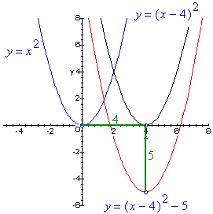
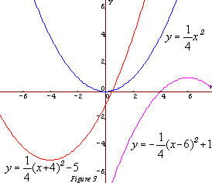
Examples of Quadratic Functions…

Slide 58
Examples of Quadratic Functions… and linear constraints!

Slide 59
Examples of Quadratic Functions… and linear constraints!

Slide 60
Why is this Important?
SVMs entail a Quadratic Optimization Problem
Need to optimize a quadratic function subject to linear constraints… easy?

Slide 61
Why is this Important?
SVMs entail a Quadratic Optimization Problem
Need to optimize a quadratic function subject to linear constraints… easy!
Quadratic optimization problems are well-known class of mathematical programming problems, and many algorithms exist:
Branch-&-Bound
Simplex
…
Notes:
https://en.wikipedia.org/wiki/Branch_and_bound

Slide 62
Why is this Important?
SVMs entail a Quadratic Optimization Problem
Need to optimize a quadratic function subject to linear constraints… easy!
Quadratic optimization problems are well-known class of mathematical programming problems, and many algorithms exist:
Branch-&-Bound
Simplex
…
Also, SVMs are cool!
The solution is a paraboloid (always) with a single global minimum, thus avoiding the problem we have with ANNs!
Notes:
https://en.wikipedia.org/wiki/Branch_and_bound

Slide 63
Why is this Important?
SVMs entail a Quadratic Optimization Problem
Need to optimize a quadratic function subject to linear constraints… easy!
Quadratic optimization problems are well-known class of mathematical programming problems, and many algorithms exist:
Branch-&-Bound
Simplex
…
Also, SVMs is cool!
The solution is a paraboloid (always) with a single global minimum, thus avoiding the problem we have with ANNs! YAY! ☺
Notes:
https://en.wikipedia.org/wiki/Branch_and_bound

Slide 64
Now here’s a problem… Selecting the margin!
denotes +1
denotes -1
Hard Margin: So far we require all data points be classified correctly
- No training error
What if the training set is noisy?

Slide 65
Now here’s a problem… Selecting the margin!
denotes +1
denotes -1
Hard Margin: So far we require all data points be classified correctly
- No training error
What if the training set is noisy?
OVERFITTING!

Slide 66
Now here’s a problem… Selecting the margin!
denotes +1
denotes -1
Hard Margin: So far we require all data points be classified correctly
- No training error
What if the training set is noisy?
OVERFITTING!
More on this further down the line!

Slide 67
Soft Margin Classification
Slack variables ξi can be added to allow misclassification of difficult or noisy examples.
What should our quadratic optimization criterion be?
Minimize
ε₁₁
ε₂
wx+b=1
ε₇
wx+b=0
wx+b=-1

Slide 68
Soft Margin Classification
Slack variables ξi can be added to allow misclassification of difficult or noisy examples.
What should our quadratic optimization criterion be?
Minimize
ε₁₁
ε₂
wx+b=1
ε₇
wx+b=0
wx+b=-1
This is a parameter we can control and fine-tune!

Slide 69
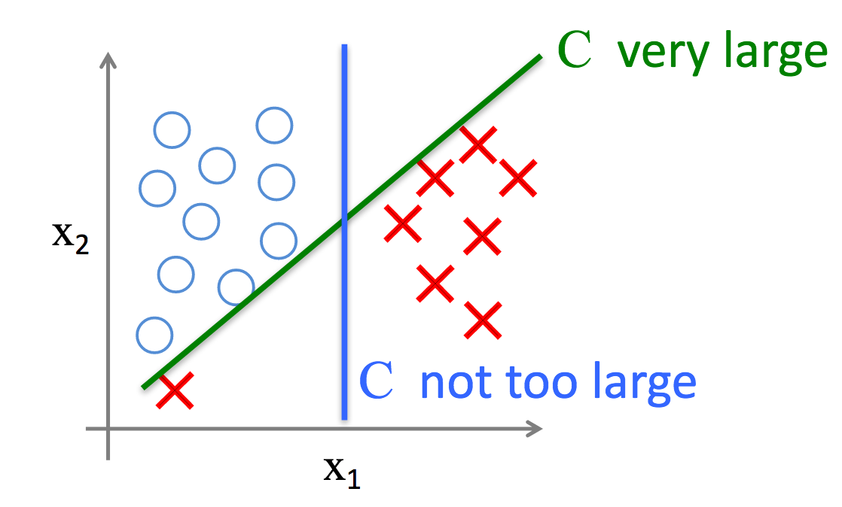
Parameter C, an example

Slide 70
Linear SVMs: Overview
The classifier is a separating hyperplane.
Most “important” training points are support vectors ➔ they define that hyperplane!
Quadratic optimization algorithms can identify which training points x_{i} are support vectors (e.g., non-zero Lagrangian approaches, Simplex, etc.)

Slide 71
Linear SVMs: Overview
The classifier is a separating hyperplane.
Most “important” training points are support vectors ➔ they define that hyperplane!
Quadratic optimization algorithms can identify which training points x_{i} are support vectors (e.g., non-zero Lagrangian approaches, Simplex, etc.)
Hold on… what happens when I need a Non-Linear SVM? Is that even possible?
Notes:
http://web.mit.edu/6.034/wwwbob/svm-notes-long-08.pdf

Slide 72
Linear SVMs: Overview (cont’d)
Datasets that are linearly separable with some noise work out great:
But what are we going to do if the dataset is just too hard?
0
x
0
x

Slide 73
Linear SVMs: Overview (cont’d)
Datasets that are linearly separable with some noise work out great:
But what are we going to do if the dataset is just too hard?
How about… mapping data to a higher-dimensional space?
0
x
0
x
x²
0
x

Slide 74
Linear SVMs: Overview (cont’d)
This is exactly what we did to figure out how to instruct linear SVMs and how they worked…
How about… mapping data to a higher-dimensional space?
0
x
x²
0
x

Slide 75
Linear SVMs: Overview (cont’d)
So in essence: we didn’t know how to classify our dataset yet… but to inform our process we considered a higher plane of existence!

Slide 76

Linear SVMs: Overview (cont’d)
So in essence: we didn’t know how to classify our dataset yet… but to inform our process we considered a higher plane of existence!

Slide 77
Linear SVMs: Overview (cont’d)
So in essence: we didn’t know how to classify our dataset yet… but to inform our process we considered a higher plane of existence!
Let’s do the same again!

Slide 78

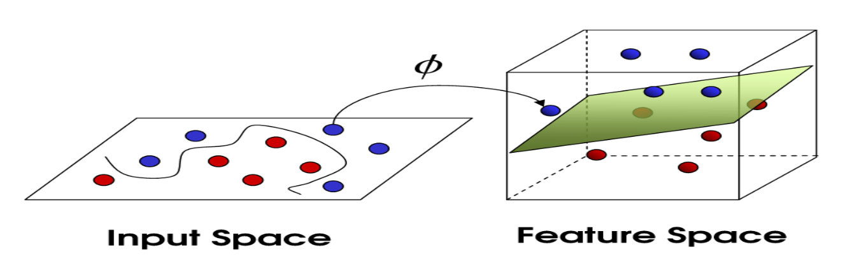
A higher plane of existence…

Slide 79
Non-Linear SVMs: Feature Spaces!
General idea: the original input space can always be mapped to some higher-dimensional feature space where the training set is linearly separable:
Φ: x → φ(x)

Slide 80
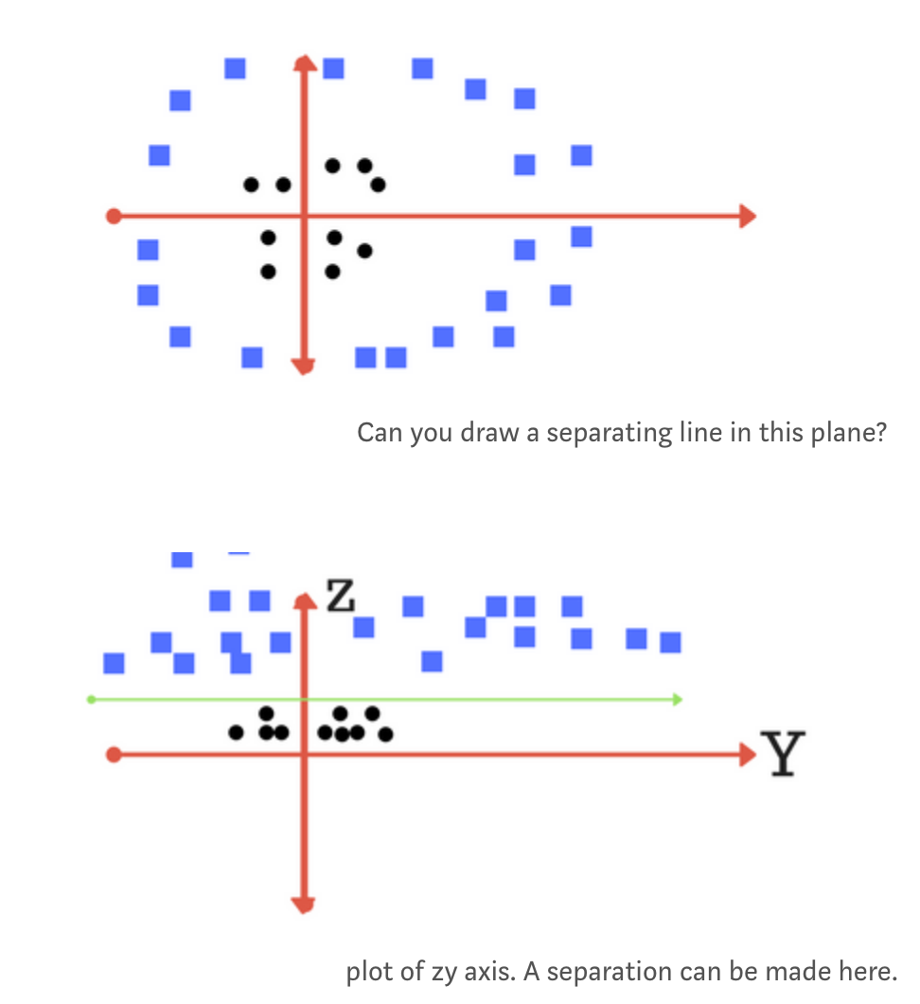
Non-Linear SVMs: Feature Spaces!
General idea: the original input space can always be mapped to some higher-dimensional feature space where the training set is linearly separable:

Slide 81
Non-Linear SVMs: Feature Spaces!
General idea: the original input space can always be mapped to some higher-dimensional feature space where the training set is linearly separable:

Slide 82
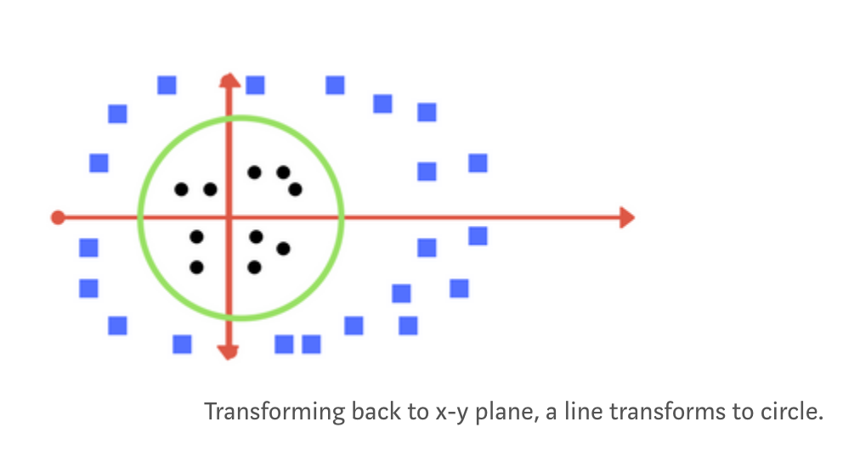
Non-Linear SVMs: Feature Spaces!
General idea: the original input space can always be mapped to some higher-dimensional feature space where the training set is linearly separable:

Slide 83

So what happens when there is no clear hyperplane?
Data are rarely ever as clean as e.g. our simple tennis example. A dataset will often look more like the jumbled balls below which represent a linearly non separable dataset.
In order to classify a dataset like the one above it’s necessary to move away from a 2d view of the data to a 3d view. Explaining this is easiest with another simplified example. Imagine that our two sets of colored balls above are sitting on a sheet and this sheet is lifted suddenly, launching the balls into the air. While the balls are up in the air, you use the sheet to separate them. This ‘lifting’ of the balls represents the transformation of data into a higher dimension…

Slide 84
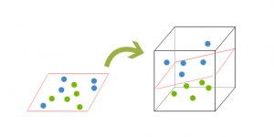
Because we are now in three dimensions, our hyperplane can no longer be a line. It must now be a plane as shown in the example above. The idea is that the data will continue to be mapped into higher and higher dimensions until a hyperplane can be formed to segregate it.

Slide 85
Thankfully…
Thankfully, you don’t have to guess/derive the transformation every time for your data set…
There’s algorithms for that, and SVM uses them!

Slide 86

Thankfully…
Thankfully, you don’t have to guess/derive the transformation every time for your data set…
There’s algorithms for that, and SVM uses them!
But they all amount to the same trick…

Slide 87
Thankfully… the trick!
Incrementing the space order so that it is easier to find a separating function/hyperplane

Slide 88
Thankfully… the trick!
Incrementing the space order so that it is easier to find a separating function/hyperplane
This is known as the Kernel trick!

Slide 89
The “Kernel Trick” Explained!
Sec. 15.2.3
The linear SVM relies on an inner product between vectors K(x_{i},x_{j})=x_{i}. x_{j}

Slide 90
The “Kernel Trick” Explained!
Sec. 15.2.3
The linear SVM relies on an inner product between vectors K(x_{i},x_{j})=x_{i}. x_{j}
The inner product is «just» the product operation in a space that generalises the euclidean space (our 3D space) to vector spaces of any (possibly infinite) dimension.
Notes:
This operation is often computationally cheaper than the explicit computation of the coordinates

Slide 91
The “Kernel Trick” Explained!
Sec. 15.2.3
The linear SVM relies on an inner product between vectors K(x_{i},x_{j})=x_{i}. x_{j}
The inner product is «just» the product operation in a space that generalises the euclidean space (our 3D space) to vector spaces of any (possibly infinite) dimension.
So… the inner product for the euclidean plane is our regular product, i.e., the scalar product.
Notes:
This operation is often computationally cheaper than the explicit computation of the coordinates

Slide 92
The “Kernel Trick” Explained!
Sec. 15.2.3
The linear SVM relies on an inner product between vectors K(x_{i},x_{j})=x_{i}. X_{j}
If every datapoint is mapped into high-dimensional space via some transformation Φ: x → φ(x), the inner product becomes:
K(x_{i},x_{j})= φ(x_{i}) . φ(x_{j})

Slide 93
The “Kernel Trick” Explained!
Sec. 15.2.3
The linear SVM relies on an inner product between vectors K(x_{i},x_{j})=x_{i}. X_{j}
If every datapoint is mapped into high-dimensional space via some transformation Φ: x → φ(x), the inner product becomes:
K(x_{i},x_{j})= φ(x_{i}) . φ(x_{j})
A kernel function is some function that corresponds to an inner product in some expanded feature space.

Slide 94
The “Kernel Trick” Explained!
Sec. 15.2.3
The linear SVM relies on an inner product between vectors K(x_{i},x_{j})=x_{i}. X_{j}
If every datapoint is mapped into high-dimensional space via some transformation Φ: x → φ(x), the inner product becomes:
K(x_{i},x_{j})= φ(x_{i}) . φ(x_{j})
A kernel function is some function that corresponds to an inner product in some expanded feature space.
Expanded, meaning it’s a higher-order dimensional space w.r.t. the data!

Slide 95
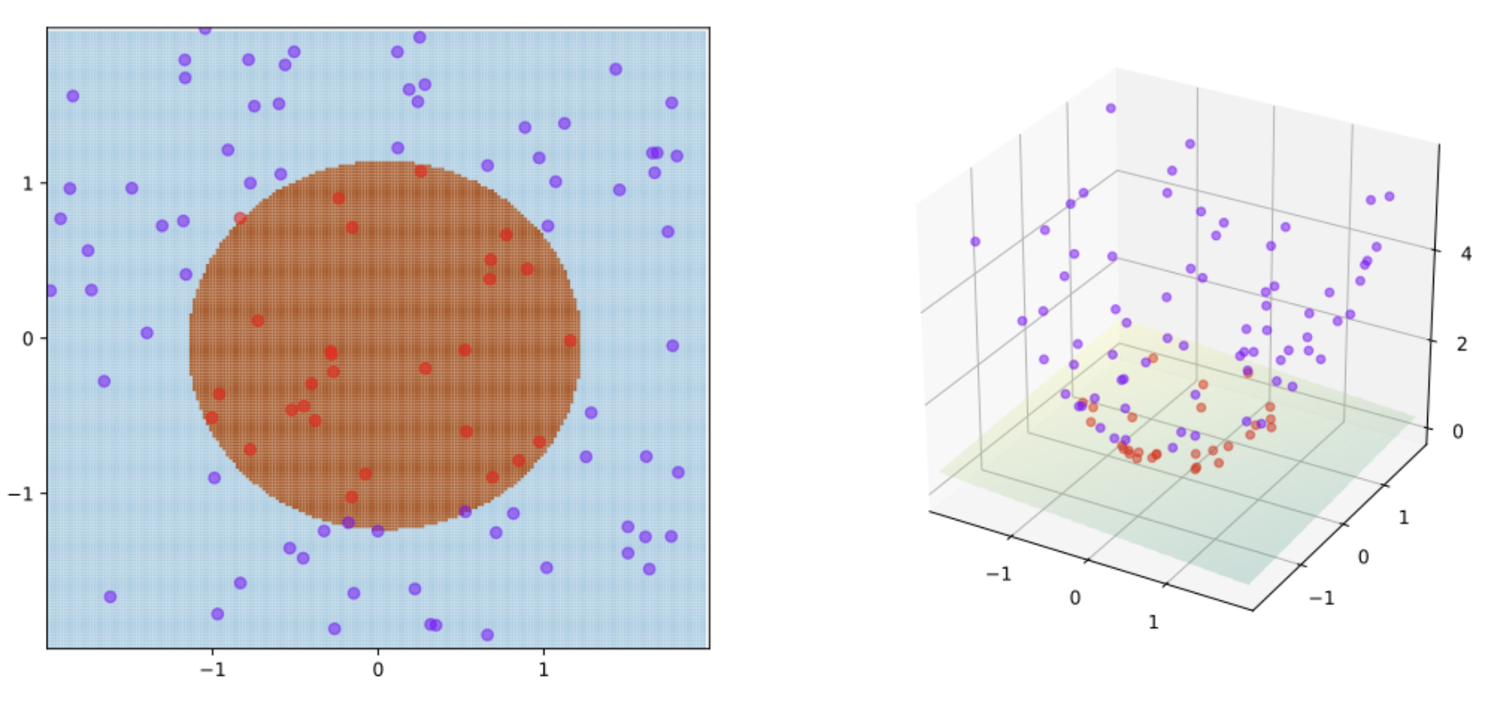
The kernel Trick, example from before… but better ☺
SVM with kernel given by φ((a, b)) = (a, b, a² + b²) and thus K(x, y) = x•y + x² y². The training points are mapped to a 3-dimensional space where a separating hyperplane can be easily found

Slide 96
The “Kernel Trick” Explained!
Sec. 15.2.3
The linear classifier relies on an inner product between vectors K(x_{i},x_{j})=x_{i}^{T}x_{j}
If every datapoint is mapped into high-dimensional space via some transformation Φ: x → φ(x), the inner product becomes:
K(x_{i},x_{j})= φ(x_{i}) ^{T}φ(x_{j})
A kernel function is some function that corresponds to an inner product in some expanded feature space.
For example…
2-dimensional vectors x=[x₁ x₂]; let K(x_{i},x_{j})=(1 + x_{i}^{T}x_{j})²,
Need to show that K(x_{i},x_{j})= φ(x_{i})^{T}φ(x_{j}):
K(x_{i},x_{j})=(1 + x_{i}^{T}x_{j})² = 1+ x_{i1}²x_{j1}² + 2 x_{i1}x_{j1} x_{i2}x_{j2}+ x_{i2}²x_{j2}² + 2x_{i1}x_{j1} + 2x_{i2}x_{j2} + […] =

Slide 97
The “Kernel Trick” Explained!
Sec. 15.2.3
The linear classifier relies on an inner product between vectors K(x_{i},x_{j})=x_{i}^{T}x_{j}
If every datapoint is mapped into high-dimensional space via some transformation Φ: x → φ(x), the inner product becomes:
K(x_{i},x_{j})= φ(x_{i}) ^{T}φ(x_{j})
A kernel function is some function that corresponds to an inner product in some expanded feature space.
For example…
2-dimensional vectors x=[x₁ x₂]; let K(x_{i},x_{j})=(1 + x_{i}^{T}x_{j})²,
Need to show that K(x_{i},x_{j})= φ(x_{i})^{T}φ(x_{j}):
K(x_{i},x_{j})=(1 + x_{i}^{T}x_{j})² = 1+ x_{i1}²x_{j1}² + 2 x_{i1}x_{j1} x_{i2}x_{j2}+ x_{i2}²x_{j2}² + 2x_{i1}x_{j1} + 2x_{i2}x_{j2} + […] =
For all T!

Slide 98
The “Kernel Trick” Explained!
Sec. 15.2.3
The linear classifier relies on an inner product between vectors K(x_{i},x_{j})=x_{i}^{T}x_{j}
If every datapoint is mapped into high-dimensional space via some transformation Φ: x → φ(x), the inner product becomes:
K(x_{i},x_{j})= φ(x_{i}) ^{T}φ(x_{j})
A kernel function is some function that corresponds to an inner product in some expanded feature space.
Example:
2-dimensional vectors x=[x₁ x₂]; let K(x_{i},x_{j})=(1 + x_{i}^{T}x_{j})²,
Need to show that K(x_{i},x_{j})= φ(x_{i})^{T}φ(x_{j}):
K(x_{i},x_{j})=(1 + x_{i}^{T}x_{j})² = 1+ x_{i1}²x_{j1}² + 2 x_{i1}x_{j1} x_{i2}x_{j2}+ x_{i2}²x_{j2}² + 2x_{i1}x_{j1} + 2x_{i2}x_{j2}=
= [1 x_{i1}² √2 x_{i1}x_{i2} x_{i2}² √2x_{i1} √2x_{i2}]^{T} [1 x_{j1}² √2 x_{j1}x_{j2} x_{j2}² √2x_{j1} √2x_{j2}]
I’m just putting in evidence this quantity…

Slide 99
The “Kernel Trick” Explained!
Sec. 15.2.3
The linear classifier relies on an inner product between vectors K(x_{i},x_{j})=x_{i}^{T}x_{j}
If every datapoint is mapped into high-dimensional space via some transformation Φ: x → φ(x), the inner product becomes:
K(x_{i},x_{j})= φ(x_{i}) ^{T}φ(x_{j})
A kernel function is some function that corresponds to an inner product in some expanded feature space.
Example:
2-dimensional vectors x=[x₁ x₂]; let K(x_{i},x_{j})=(1 + x_{i}^{T}x_{j})²,
Need to show that K(x_{i},x_{j})= φ(x_{i}) ^{T}φ(x_{j}):
K(x_{i},x_{j})=(1 + x_{i}^{T}x_{j})²,= 1+ x_{i1}²x_{j1}² + 2 x_{i1}x_{j1} x_{i2}x_{j2}+ x_{i2}²x_{j2}² + 2x_{i1}x_{j1} + 2x_{i2}x_{j2}=
= [1 x_{i1}² √2 x_{i1}x_{i2} x_{i2}² √2x_{i1} √2x_{i2}]^{T} [1 x_{j1}² √2 x_{j1}x_{j2} x_{j2}² √2x_{j1} √2x_{j2}]
= φ(x_{i}) ^{T}φ(x_{j})
So I can impose this!
Notes:
http://www.kernel-machines.org/

Slide 100
The “Kernel Trick” Explained!
Sec. 15.2.3
The linear classifier relies on an inner product between vectors K(x_{i},x_{j})=x_{i}^{T}x_{j}
If every datapoint is mapped into high-dimensional space via some transformation Φ: x → φ(x), the inner product becomes:
K(x_{i},x_{j})= φ(x_{i}) ^{T}φ(x_{j})
A kernel function is some function that corresponds to an inner product in some expanded feature space.
Example:
2-dimensional vectors x=[x₁ x₂]; let K(x_{i},x_{j})=(1 + x_{i}^{T}x_{j})²,
Need to show that K(x_{i},x_{j})= φ(x_{i}) ^{T}φ(x_{j}):
K(x_{i},x_{j})=(1 + x_{i}^{T}x_{j})²,= 1+ x_{i1}²x_{j1}² + 2 x_{i1}x_{j1} x_{i2}x_{j2}+ x_{i2}²x_{j2}² + 2x_{i1}x_{j1} + 2x_{i2}x_{j2}=
= [1 x_{i1}² √2 x_{i1}x_{i2} x_{i2}² √2x_{i1} √2x_{i2}]^{T} [1 x_{j1}² √2 x_{j1}x_{j2} x_{j2}² √2x_{j1} √2x_{j2}]
= φ(x_{i}) ^{T}φ(x_{j}) where φ(x) = [1 x₁² √2 x₁x₂ x₂² √2x₁ √2x₂]

Slide 101
The “Kernel Trick” Explained!
Sec. 15.2.3
The linear classifier relies on an inner product between vectors K(x_{i},x_{j})=x_{i}^{T}x_{j}
If every datapoint is mapped into high-dimensional space via some transformation Φ: x → φ(x), the inner product becomes:
K(x_{i},x_{j})= φ(x_{i}) ^{T}φ(x_{j})
A kernel function is some function that corresponds to an inner product in some expanded feature space.
What I have shown in the example is that I can use a kernel function and, in general, it *never* changes the meaning or properties of my data!

Slide 102
The “Kernel Trick” Explained! Typical kernel functions
Linear: K(x_{i},x_{j})= x_{i} . x_{j}
Polynomial of power p: K(x_{i},x_{j})= (1+ x_{i} . x_{j})^{p}
Gaussian (radial-basis function network):
Sigmoid: K(x_{i},x_{j})= tanh(β₀x_{i} . x_{j} + β₁)
…

Slide 103
Nonlinear SVMs, essentially…
SVM locates a separating hyperplane in the feature space and classifies points in that space;
SVM does not need to represent all the space explicitly, rather, it uses the kernel function as a start for the solution;
In multi-dimensional spaces, the kernel function plays the role of the dot product (scalar product) in the feature space;

Slide 104
The “Kernel Trick” Explained! Choosing kernel functions
There are rules of thumb… but No Free Lunch!
Start with simpler kernel functions first (e.g., polynomial);
Experiment and change kernel as more insights into the data are gained;
Consider the expense of experimentation!
Notes:
https://ti.arc.nasa.gov/m/profile/dhw/papers/78.pdf
https://img.sauf.ca/pictures/2018-07-26/a06ad4c7182d57fdcb9077bd0571c959.pdf

Slide 105
The “Kernel Trick” Explained! Choosing kernel functions
There are rules of thumb… but No Free Lunch!
Start with simpler kernel functions first (e.g., polynomial);
Experiment and change kernel as more insights into the data are gained;
Consider the expense of experimentation!
Notes:
https://ti.arc.nasa.gov/m/profile/dhw/papers/78.pdf
https://img.sauf.ca/pictures/2018-07-26/a06ad4c7182d57fdcb9077bd0571c959.pdf

Slide 106
No Free Lunch Theorem
«Any two Optimization algorithms A and B are equivalent when their performance is averaged across all possible problems»
Cit. Wolpert and Macready 2005
Notes:
http://www.no-free-lunch.org/

Slide 107
No Free Lunch Theorem
«Any two Optimization algorithms A and B are equivalent when their performance is averaged across all possible problems»
Cit. Wolpert and Macready 2005
Meaning that, regardless of what you know about the data
you will *always* need to experiment with ML algorithms and approaches
Notes:
http://www.no-free-lunch.org/

Slide 108
No Free Lunch Theorem
«Any two Optimization algorithms A and B are equivalent when their performance is averaged across all possible problems»
Cit. Wolpert and Macready 2005
Meaning that, regardless of what you know about the data
you will *always* need to experiment with ML algorithms and approaches
Or even different settings of the same algorithm!
Notes:
http://www.no-free-lunch.org/

Slide 109
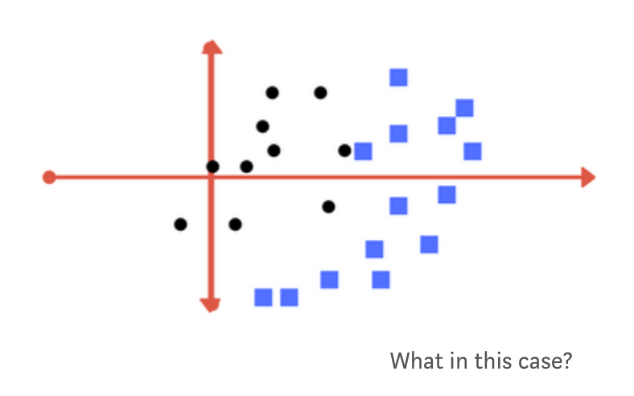
For example…

Slide 110
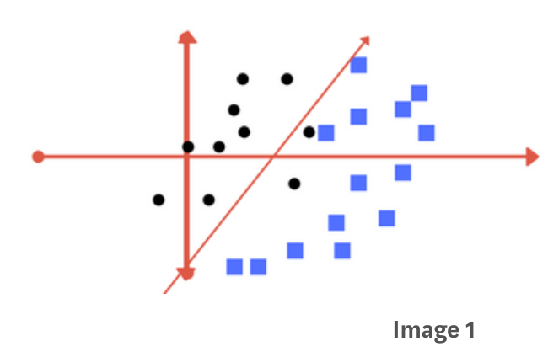
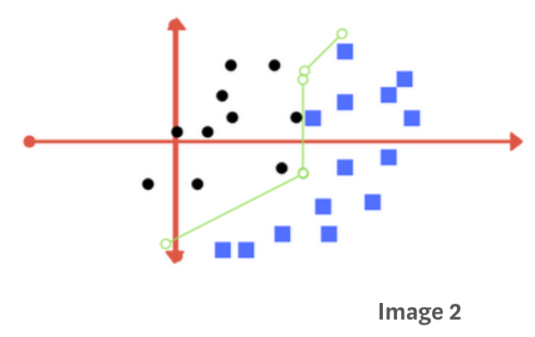
For example…
Which one is better?

Slide 111
For example…
Neither, in principle… it’s a trade-off!

Slide 112
For example…
Neither, in principle… it’s a trade-off!

Slide 113
For example…
Neither, in principle… it’s a trade-off!
CON: Some «bias» of the model w.r.t. the data
PRO: Good performance

Slide 114
For example…
Neither, in principle… it’s a trade-off!
CON: slow training…
PRO: precise w.r.t.
data

Slide 115
For example…
Neither, in principle… it’s a trade-off!
CON: slow training…
OVERFITTING!
PRO: ‘too’ precise w.r.t. data!

Slide 116
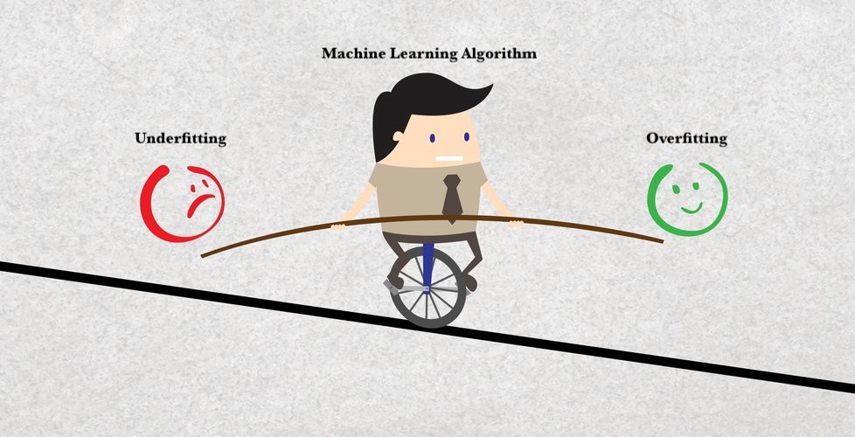
So essentially…
The NFL theorem implies:

Slide 117
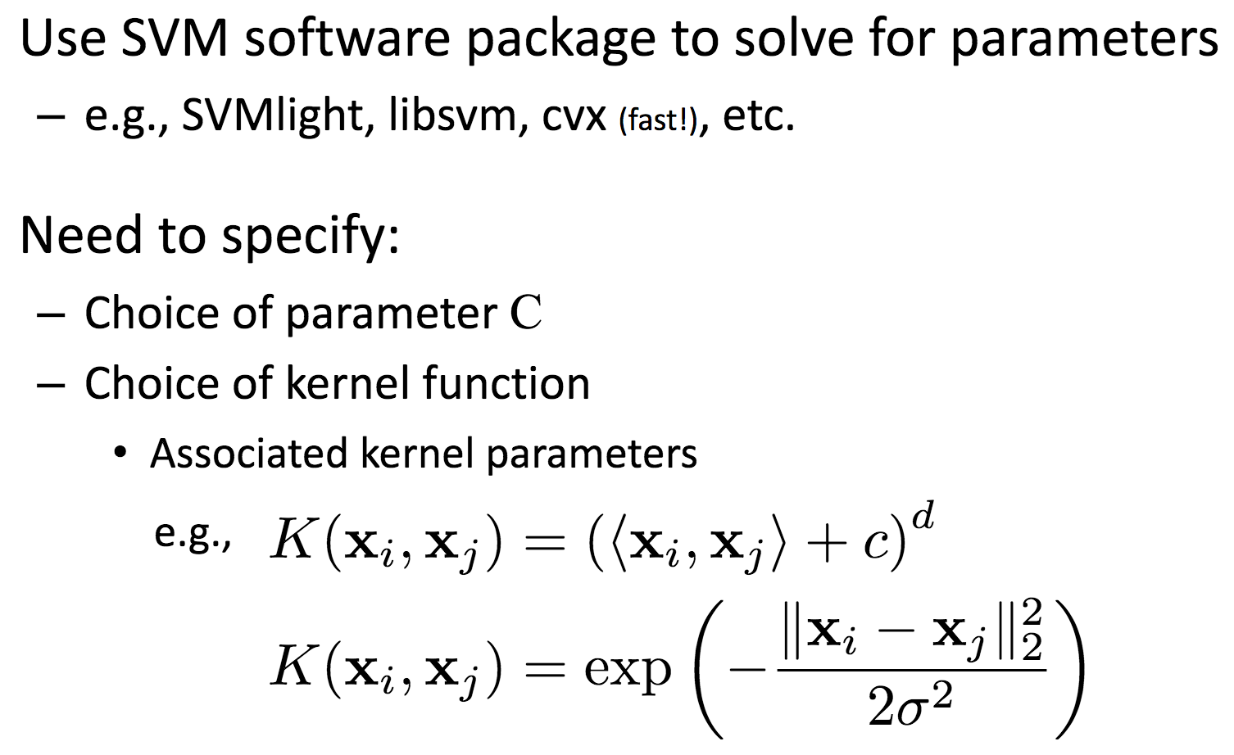
The “Kernel Trick” Explained! Choosing kernel functions
There are rules of thumb… but No Free Lunch!

Slide 118
The “Kernel Trick” Explained! Choosing kernel functions
There are rules of thumb… but No Free Lunch!

Slide 119
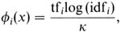
Putting it all together: Text Categorization using SVMs
IR’s vector space model (aka bag-of-words representation)
A doc is represented by a vector indexed by a pre-fixed set or dictionary of terms
Values of an entry can be binary or weights
Normalization, stop words, word stems
Doc x => φ(x)

Slide 120
Text Categorization using SVM
The distance between two documents is φ(x)·φ(z)
K(x,z) = 〈φ(x)·φ(z) is a valid kernel, SVM can be used with K(x,z) for discrimination.
Why SVM?
-High dimensional input space
-Few irrelevant features (dense concept)
-Sparse document vectors (sparse instances)
-Text categorization problems are linearly separable

Slide 121
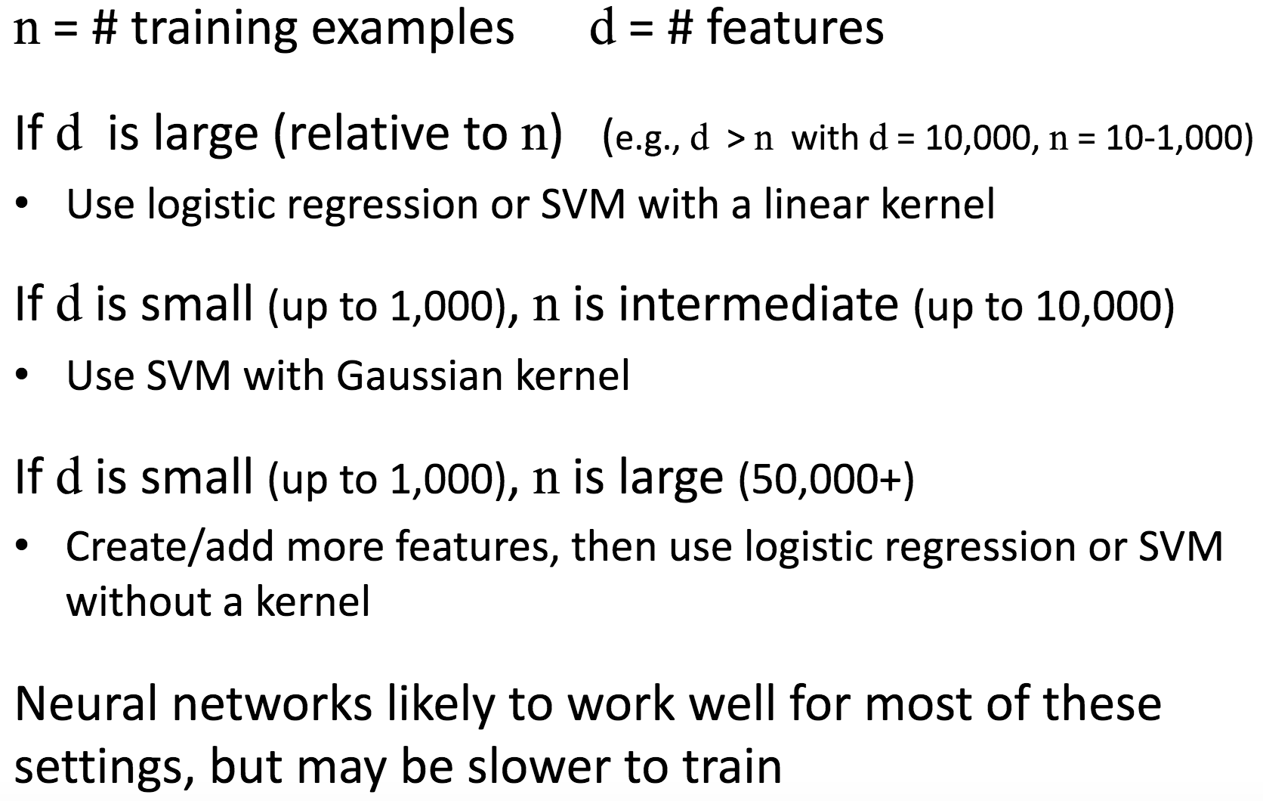
SVMs vs. Regression Modelling*
*Insights from Andrew Ng

Slide 122
So, essentially…
What t.h. are SVMs?
An SVM is…
…a discriminative classifier formally defined by a separating hyperplane
Given labeled training data (supervised learning), the algorithm outputs an optimal hyperplane which categorizes new examples.
In two dimentional space this hyperplane is a line dividing a plane in two parts where in each class lay in either side

Slide 123
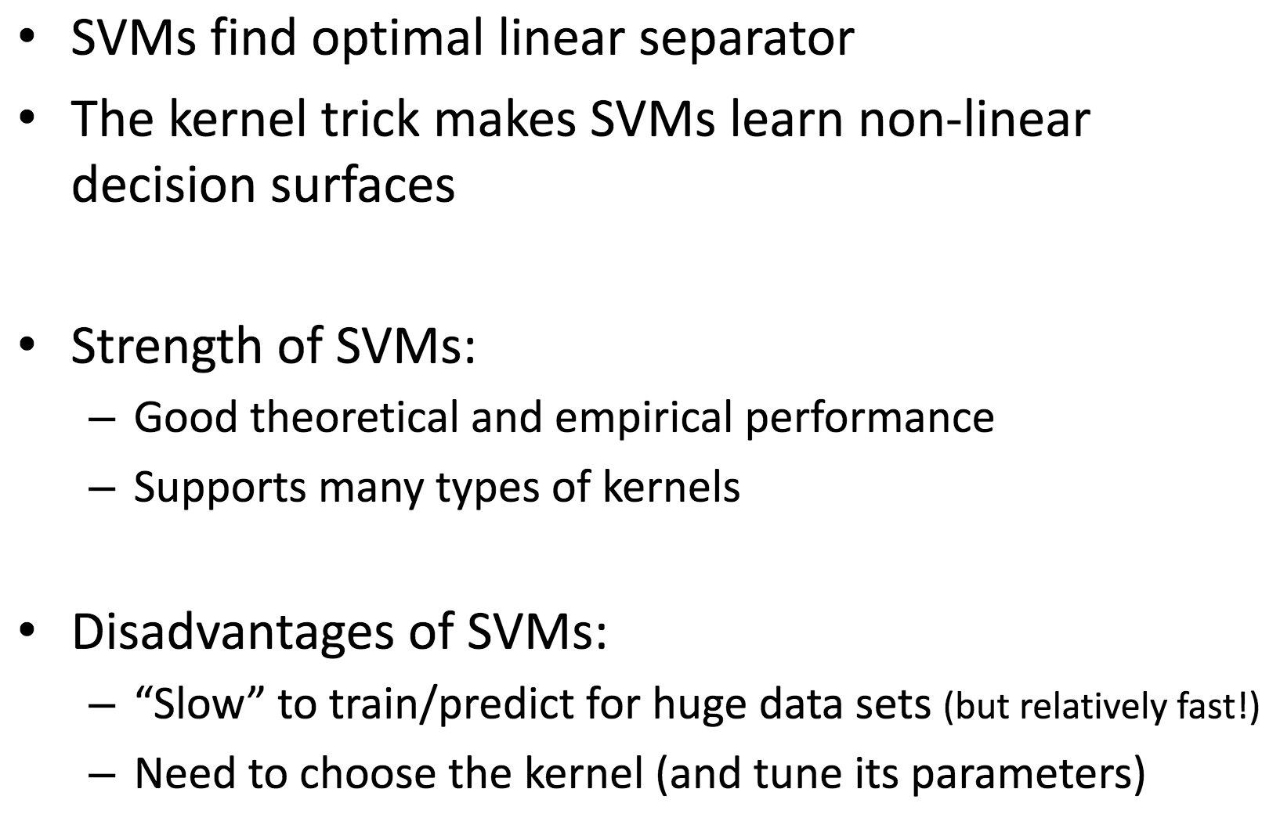
What are their functioning principles? & When do I use them?

Slide 124
Typical Issues
Choice of kernel
- Gaussian or polynomial kernel is default
- if ineffective, more elaborate kernels are needed
- domain experts can give assistance in formulating appropriate similarity measures
Choice of kernel parameters
- e.g. σ in Gaussian kernel
- σ is the distance between closest points with different classifications
- In the absence of reliable criteria, applications rely on the use of a validation set or cross-validation to set such parameters.
Optimization criterion – Hard margin vs. Soft margin
- a lengthy series of experiments in which various parameters are tested

Slide 125
Questions?
Thanks!
Notes:
https://medium.com/machine-learning-101/chapter-2-svm-support-vector-machine-theory-f08
12effc72

Slide 126
Software
A list of SVM implementation can be found at http://www.kernel-machines.org/software.html
Some implementation (such as LIBSVM) can handle multi-class classification
SVMLight is among one of the earliest implementation of SVM
Several Matlab toolboxes for SVM are also available

Slide 127
Other Resources
Christopher J. C. Burges. 1998. A Tutorial on Support Vector Machines for Pattern Recognition
S. T. Dumais. 1998. Using SVMs for text categorization, IEEE Intelligent Systems, 13(4)
S. T. Dumais, J. Platt, D. Heckerman and M. Sahami. 1998. Inductive learning algorithms and representations for text categorization. CIKM ’98, pp. 148-155.
Yiming Yang, Xin Liu. 1999. A re-examination of text categorization methods. 22nd Annual International SIGIR
Tong Zhang, Frank J. Oles. 2001. Text Categorization Based on Regularized Linear Classification Methods. Information Retrieval 4(1): 5-31
Trevor Hastie, Robert Tibshirani and Jerome Friedman. Elements of Statistical Learning: Data Mining, Inference and Prediction. Springer-Verlag, New York.
T. Joachims, Learning to Classify Text using Support Vector Machines. Kluwer, 2002.
Fan Li, Yiming Yang. 2003. A Loss Function Analysis for Classification Methods in Text Categorization. ICML 2003: 472-479.
Tie-Yan Liu, Yiming Yang, Hao Wan, et al. 2005. Support Vector Machines Classification with Very Large Scale Taxonomy, SIGKDD Explorations, 7(1): 36-43.
‘Classic’ Reuters-21578 data set: http://www.daviddlewis.com /resources /testcollections/reuters21578/

